Slide 1
S2-19_DSECLZC415 CLUSTERING – SESSION 10 & 11 COMBINED SLIDES – REMOVED THE REDUNDANCIES- REORDERED/ORGANISED SLIDES
JULY 25 – Dr.D.VENKATA SUBRAMANIAN
Slide Courtesy: Prof. T.V. Rao

Slide 2
What is Cluster Analysis?
Finding groups of objects such that the objects in a group will be similar (or related) to one another and different from (or unrelated to) the objects in other groups
Inter-cluster distances are maximized
Intra-cluster distances are minimized

Slide 3
Quality: What Is Good Clustering?
A good clustering method will produce high quality clusters with
high intra-class similarity
low inter-class similarity
The quality of a clustering result depends on both the similarity measure used by the method and its implementation
The quality of a clustering method is also measured by its ability to discover some or all of the hidden patterns

Slide 4
Types of Clusterings
A clustering is a set of clusters
An important distinction among types of clusterings : hierarchical and partitional sets of clusters
Partitional Clustering
A division data objects into non-overlapping subsets (clusters) such that each data object is in exactly one subset
Hierarchical clustering
A set of nested clusters organized as a hierarchical tree

Slide 5
Partitional Clustering Method K-Means
Strength: Efficient: O(tkn), where n is # objects, k is # clusters, and t is # iterations. Normally, k, t << n.
Comparing: PAM: O(k(n-k)² ), CLARA: O(ks² + k(n-k))
Comment: Often terminates at a local optimal.
Weakness
Applicable only to objects in a continuous n-dimensional space
Using the k-modes method for categorical data
In comparison, k-medoids can be applied to a wide range of data
Need to specify k, the number of clusters, in advance
Sensitive to noisy data and outliers
Not suitable to discover clusters with non-convex shapes

Slide 6
Hierarchical methods

Slide 7
Hierarchical Clustering
Produces a set of nested clusters organized as a hierarchical tree
Can be visualized as a dendrogram
A tree like diagram that records the sequences of merges or splits

Slide 8
Strengths of Hierarchical Clustering
Do not have to assume any particular number of clusters
Any desired number of clusters can be obtained by ‘cutting’ the dendogram at the proper level
They may correspond to meaningful taxonomies
Example in biological sciences (e.g., animal kingdom, phylogeny reconstruction, …)
animal
vertebrate
invertebrate
fish reptile amphib. mammal worm insect crustacean

Slide 9
Hierarchical Clustering
Two main types of hierarchical clustering
Agglomerative:
Start with the points as individual clusters
At each step, merge the closest pair of clusters until only one cluster (or k clusters) left
Divisive:
Start with one, all-inclusive cluster
At each step, split a cluster until each cluster contains a point (or there are k clusters)
Traditional hierarchical algorithms use a similarity or distance matrix
Merge or split one cluster at a time

Slide 10
Agglomerative Clustering Algorithm
More popular hierarchical clustering technique
Basic algorithm is straightforward
Compute the proximity matrix
Let each data point be a cluster
Repeat
Merge the two closest clusters
Update the proximity matrix
Until only a single cluster remains
Key operation is the computation of the proximity of two clusters
Different approaches to defining the distance between clusters distinguish the different algorithms

Slide 11
Starting Situation
Start with clusters of individual points and a proximity matrix
p1
p2
p3
p4
p5
. . .
p1
p2
p3
p4
p5
.
.
.
Proximity Matrix

Slide 12
Intermediate Situation
After some merging steps, we have some clusters
C1
C2
C3
C4
C5
C1
C2
C3
C3
C4
C4
C5
Proximity Matrix
C1
C2
C5

Slide 13
Intermediate Situation
We want to merge the two closest clusters (C2 and C5) and update the proximity matrix.
C1
C2
C3
C4
C5
C1
C2
C3
C3
C4
C4
C5
Proximity Matrix
C1
C2
C5

Slide 14
How to Define Inter-Cluster Similarity
p1
p2
p3
p4
p5
. . .
Similarity?
p1
p2
p3
p4
MIN
MAX
Group Average
Distance Between Centroids
Other methods driven by an objective function
p5
.
.
.
Proximity Matrix

Slide 15
How to Define Inter-Cluster Similarity
p1
p2
p3
p4
p5
. . .
p1
p2
p3
p4
p5
MIN
MAX
Group Average
Distance Between Centroids
Other methods driven by an objective function
.
.
.
Proximity Matrix

Slide 16
How to Define Inter-Cluster Similarity
p1
p2
p3
p4
p5
. . .
p1
p2
p3
p4
p5
MIN
MAX
Group Average
Distance Between Centroids
Other methods driven by an objective function
.
.
.
Proximity Matrix

Slide 17
How to Define Inter-Cluster Similarity
p1
p2
p3
p4
p5
. . .
p1
p2
p3
p4
p5
MIN
MAX
Group Average
Distance Between Centroids
Other methods driven by an objective function
.
.
.
Proximity Matrix

Slide 18
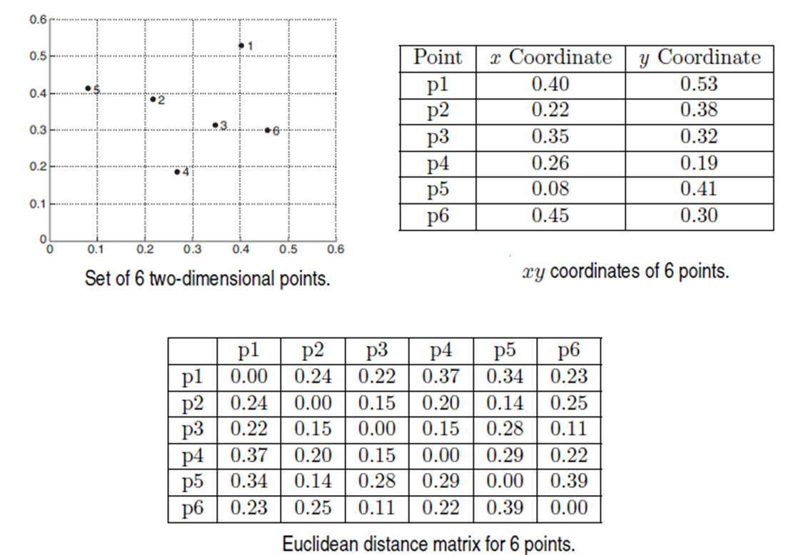
Clustering Example

Slide 19
How to Define Inter-Cluster Similarity
p1
p2
p3
p4
p5
. . .
p1
×
×
p2
p3
p4
p5
MIN
MAX
Group Average
Distance Between Centroids
Other methods driven by an objective function
.
.
.
Proximity Matrix

Slide 20
Hierarchical Clustering: MIN
Similarity of two clusters is based on the two most similar (closest) points in the different clusters
Determined by one pair of points, i.e., by one link in the proximity graph.
5
1
3
5
2
1
2
3
6
4
4
Nested Clusters
Dendrogram

Slide 21
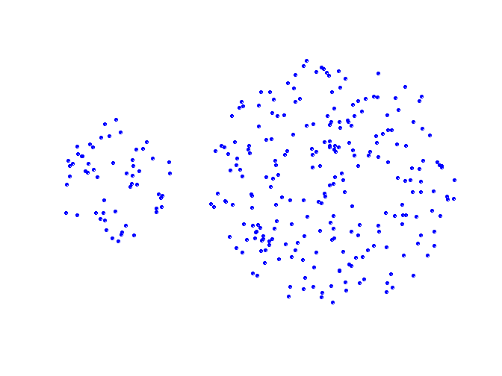
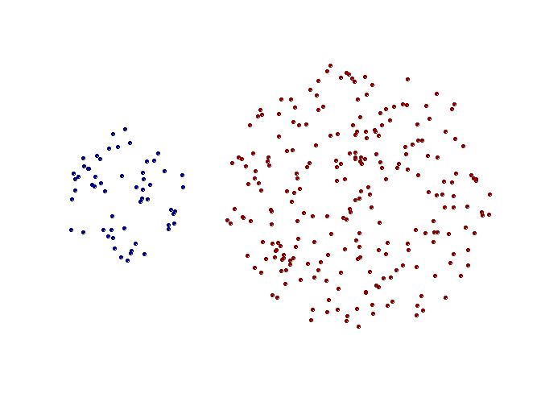
Strength of MIN
Original Points
Two Clusters
Can handle non-elliptical shapes

Slide 22
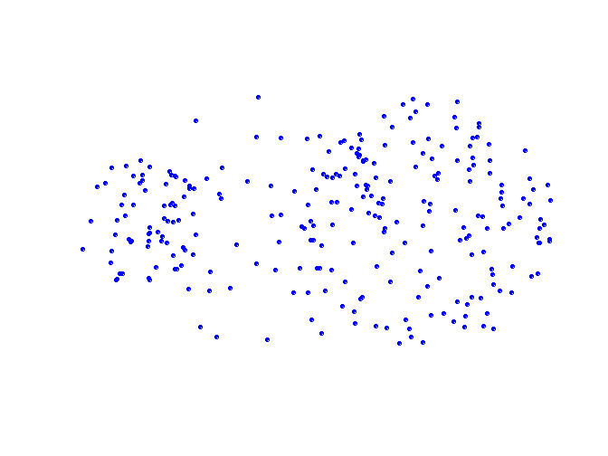
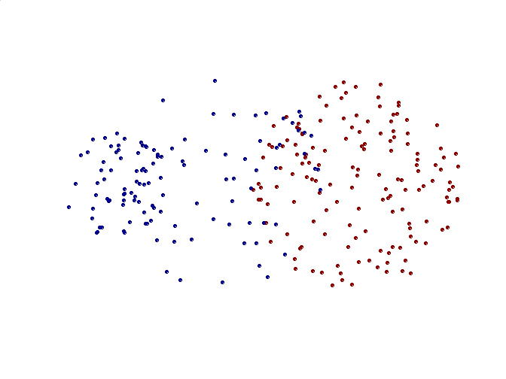
Limitations of MIN
Original Points
Two Clusters
Sensitive to noise and outliers

Slide 23
Hierarchical Clustering: MAX
Similarity of two clusters is based on the two least similar (most distant) points in the different clusters
Determined by all pairs of points in the two clusters
4
1
2
5
5
2
3
6
3
1
4
Dendrogram
Nested Clusters

Slide 24
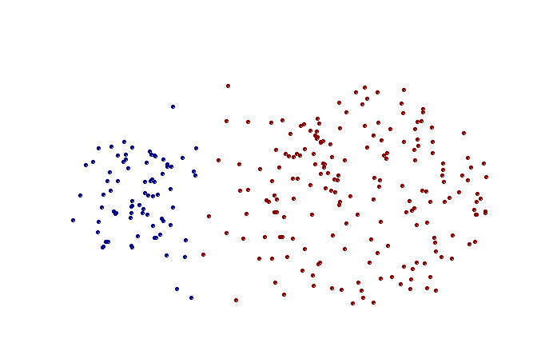
Strength of MAX
Original Points
Two Clusters
Less susceptible to noise and outliers

Slide 25
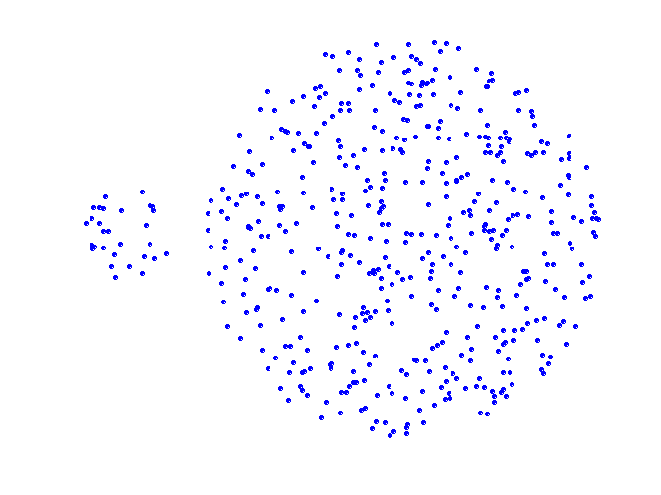
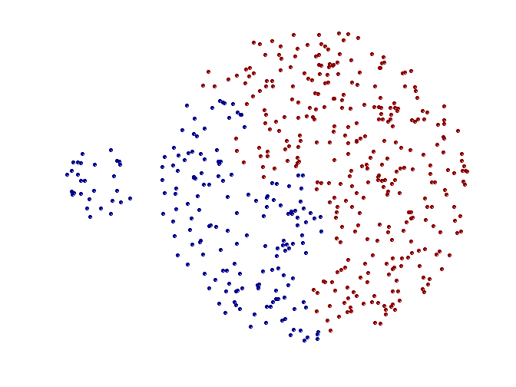
Limitations of MAX
Original Points
Two Clusters
Tends to break large clusters
Biased towards globular clusters

Slide 26
Hierarchical Clustering: Group Average
Proximity of two clusters is the average of pairwise proximity between points in the two clusters.
5
4
1
2
5
2
3
6
1
4
3
Nested Clusters
Dendrogram

Slide 27
Hierarchical Clustering: Comparison
5
1
4
1
3
2
5
5
5
2
1
MIN
2
MAX
2
3
6
3
3
6
1
4
4
4
5
4
1
2
5
2
Group Average
3
6
1
4
3

Slide 28
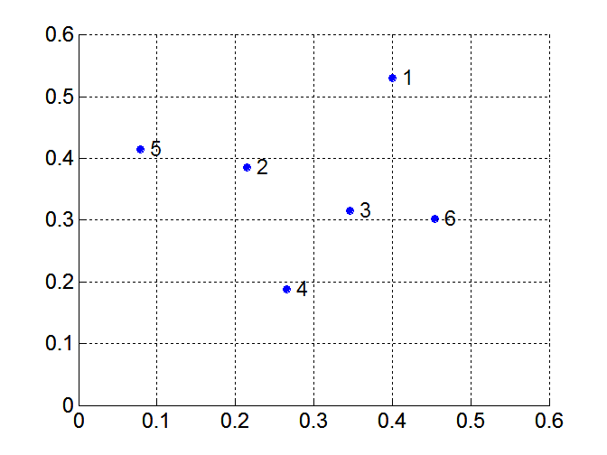
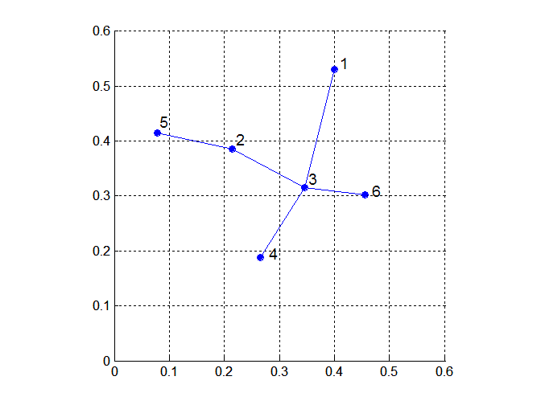
MST: Divisive Hierarchical Clustering
Build MST (Minimum Spanning Tree)
Start with a tree that consists of any point
In successive steps, look for the closest pair of points (p, q) such that one point (p) is in the current tree but the other (q) is not
Add q to the tree and put an edge between p and q

Slide 29
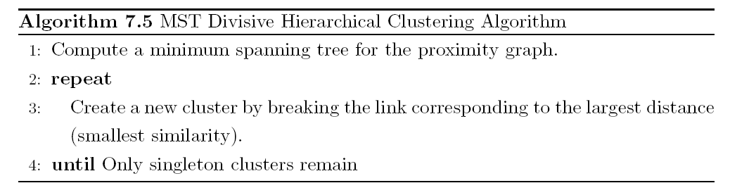
MST: Divisive Hierarchical Clustering
Use MST for constructing hierarchy of clusters

Slide 30
Hierarchical Clustering: Time and Space requirements
O(N²) space since it uses the proximity matrix.
N is the number of points.
O(N³) time in many cases
There are N steps and at each step the size, N², proximity matrix must be updated and searched
Complexity can be reduced to O(N² log(N) ) time for some approaches

Slide 31
Hierarchical Clustering: Problems and Limitations
Once a decision is made to combine two clusters, it cannot be undone
No objective function is directly minimized
Different schemes have problems with one or more of the following:
Sensitivity to noise and outliers
Difficulty handling different sized clusters and convex shapes
Breaking large clusters

Slide 32
More Hierarchical methods

Slide 33
Extensions to Hierarchical Clustering
Major weakness of agglomerative clustering methods
Can never undo what was done previously
Do not scale well: time complexity of at least O(n²), where n is the number of total objects
Integration of hierarchical & distance-based clustering
BIRCH : uses CF-tree and incrementally adjusts the quality of sub-clusters

Slide 34
BIRCH (Balanced Iterative Reducing and Clustering Using Hierarchies)
Zhang, Ramakrishnan & Livny, SIGMOD’96
Incrementally construct a CF (Clustering Feature) tree, a hierarchical data structure for multiphase clustering
Phase 1: scan DB to build an initial in-memory CF tree (a multi-level compression of the data that tries to preserve the inherent clustering structure of the data)
Phase 2: use an arbitrary clustering algorithm to cluster the leaf nodes of the CF-tree
Scales linearly: finds a good clustering with a single scan and improves the quality with a few additional scans
Weakness: handles only numeric data, and sensitive to the order of the data record

Slide 35
Clustering Feature Vector in BIRCH
Clustering Feature (CF): CF = (N, LS, SS)
N: Number of data points
LS: linear sum of N points:
SS: square sum of N points
CF = (5, (16,30),(54,190))
(3,4)
(2,6)
(4,5)
(4,7)
(3,8)

Slide 36
CF-Tree in BIRCH
Clustering feature:
Summary of the statistics for a given subcluster: the 0-th, 1st, and 2nd moments of the subcluster from the statistical point of view
Registers crucial measurements for computing cluster and utilizes storage efficiently
A CF tree is a height-balanced tree that stores the clustering features for a hierarchical clustering
A nonleaf node in a tree has descendants or “children”
The nonleaf nodes store sums of the CFs of their children
A CF tree has two parameters
Branching factor: max # of children
Threshold: max diameter of sub-clusters stored at the leaf nodes

Slide 37
The CF Tree Structure
Root
B = 7
L = 6
CF₁
CF₂
CF₃
CF₆
child₁
child₂
child₃
child₆
Non-leaf node
CF₁
CF₂
CF₃
CF₅
child₁
child₂
child₃
child₅
Leaf node
Leaf node
prev
CF₁
CF₂
CF₆
next
prev
CF₁
CF₂
CF₄
next
Each non-leaf node contains at most B entries. A leaf node contains at most L entries

Slide 38
BIRCH Steps
The first phase builds a CF tree out of the data points, a height-balanced tree data structure
In the second step, the algorithm scans all the leaf entries in the initial CF tree to rebuild a smaller CF tree, while removing outliers and grouping crowded subclusters into larger ones.
In step three an existing clustering algorithm is used to cluster all leaf entries. Here algorithm is applied directly to the subclusters represented by their CF vectors.
In (optional) step 4 the centroids of the clusters produced in step 3 are used as seeds and redistribute the data points to its closest seeds to obtain a new set of clusters

Slide 39
The Birch Algorithm
Cluster Diameter
In first phase, For each point in the input
Find closest leaf entry
Add point to leaf entry and update CF
If entry diameter > max_diameter, then split leaf, and possibly parents
Algorithm is O(n)
Concerns
Sensitive to insertion order of data points
Since we fix the size of leaf nodes, so clusters may not be so natural
Clusters tend to be spherical given the radius and diameter measures

Slide 40
Density based Cluster Analysis

Slide 41
Density-Based Clustering Methods
Clustering based on density (local cluster criterion), such as density-connected points
Major features:
Discover clusters of arbitrary shape
Handle noise
One scan
Need density parameters as termination condition
Several interesting studies:
DBSCAN: Ester, et al. (KDD’96)
OPTICS: Ankerst, et al (SIGMOD’99).
DENCLUE: Hinneburg & D. Keim (KDD’98)
CLIQUE: Agrawal, et al. (SIGMOD’98) (more grid-based)

Slide 42
Density-Based Clustering: Basic Concepts
Two parameters:
Eps: Maximum radius of the neighbourhood
MinPts: Minimum number of points in an Eps-neighbourhood of that point
N_{Eps}(p): {q belongs to D | dist(p,q) ≤ Eps}
Directly density-reachable: A point p is directly density-reachable from a point q w.r.t. Eps, MinPts if
p belongs to N_{Eps}(q)
core point condition:
|N_{Eps} (q)| ≥ MinPts
p
MinPts = 5
Eps = 1 cm
q

Slide 43
Density-Reachable and Density-Connected
Density-reachable:
A point p is density-reachable from a point q w.r.t. Eps, MinPts if there is a chain of points p₁, …, p_{n}, p₁ = q, p_{n} = p such that p_{i+1} is directly density-reachable from p_{i}
Density-connected
A point p is density-connected to a point q w.r.t. Eps, MinPts if there is a point o such that both, p and q are density-reachable from o w.r.t. Eps and MinPts
p
p₁
q
p
q
o

Slide 44
DBSCAN
DBSCAN is a density-based algorithm.
Density = number of points within a specified radius (Eps)
A point is a core point if it has more than a specified number of points (MinPts) within Eps
These are points that are at the interior of a cluster
A border point has fewer than MinPts within Eps, but is in the neighborhood of a core point
A noise point is any point that is not a core point or a border point.

Slide 45
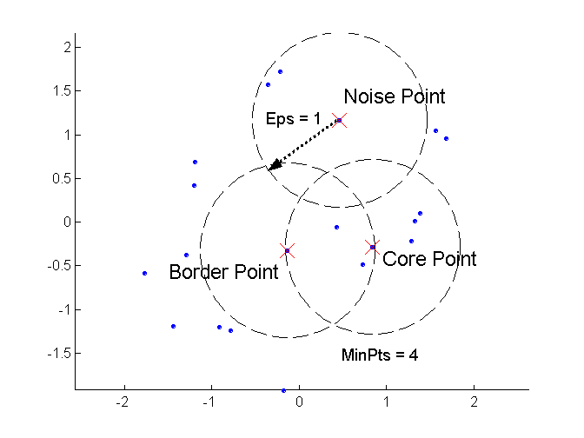
DBSCAN: Core, Border, and Noise Points

Slide 46
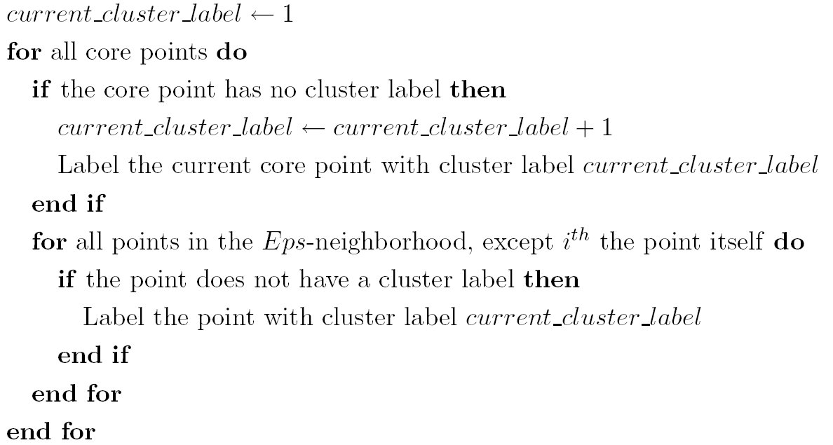
DBSCAN Algorithm
Eliminate noise points
Perform clustering on the remaining points

Slide 47
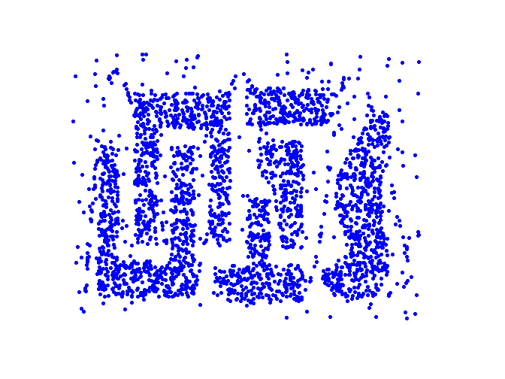
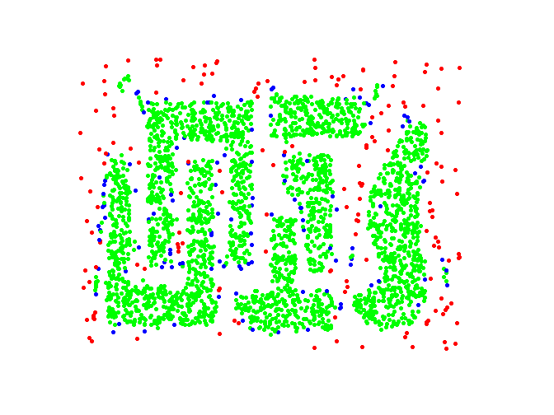
DBSCAN: Core, Border and Noise Points
Original Points
Point types: core, border and noise
Eps = 10, MinPts = 4

Slide 48
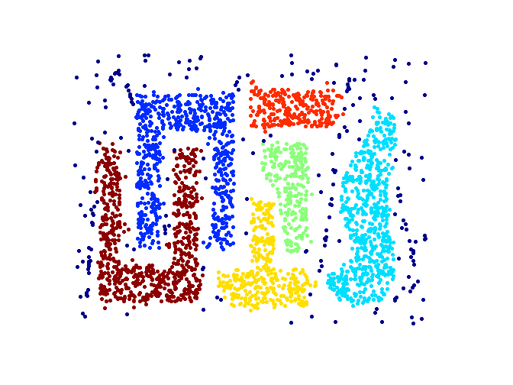
When DBSCAN Works Well
Original Points
Clusters
Resistant to Noise
Can handle clusters of different shapes and sizes

Slide 49
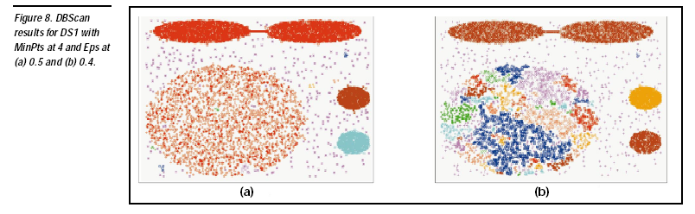

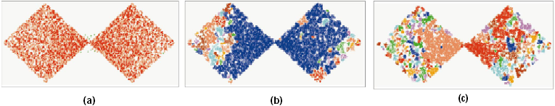
DBSCAN: Sensitive to Parameters
DBSCAN does not work well for
Varying densities
High-dimensional data

Slide 50
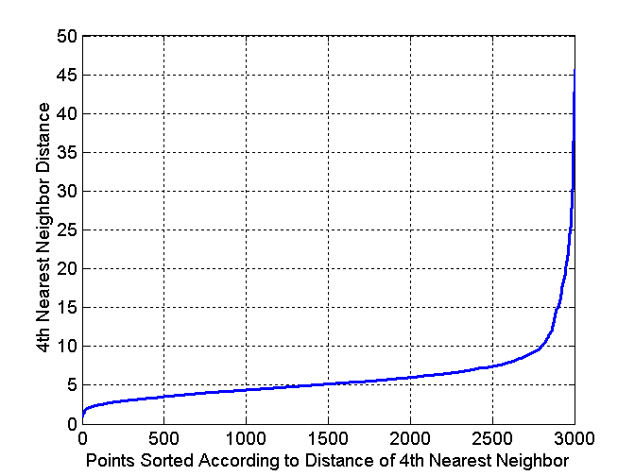
DBSCAN: Determining EPS and MinPts
Idea is that for points in a cluster, their k^{th} nearest neighbors are at roughly the same distance
Noise points have the k^{th} nearest neighbor at farther distance
So, plot sorted distance of every point to its k^{th} nearest neighbor

Slide 51
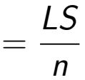
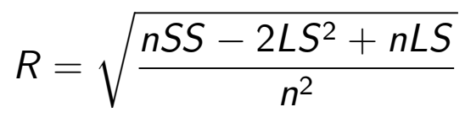
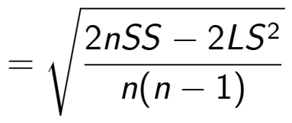

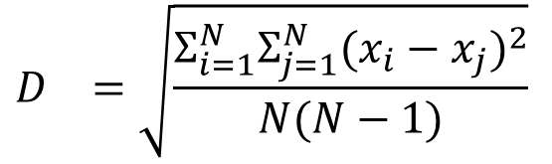

Centroid, Radius and Diameter of a Cluster
Centroid: the “middle” of a cluster
Radius: square root of average distance from any point of the cluster to its centroid
Diameter: square root of average mean squared distance between all pairs of points in the cluster
$$C_{}=\frac{Σ_{i=1}^{N}(x_{i})}{N}$$
$$R_{}=\sqrt{\frac{Σ_{i=1}^{N}(x_{i}−c_{})^{2}}{N}}$$
$$D_{}=\sqrt{\frac{Σ_{i=1}^{N}Σ_{j=1}^{N}(x_{i}−x_{j})^{2}}{N(N−1)}}$$
51
Notes:
51

Slide 52
OPTICS: A Cluster-Ordering Method (1999)
OPTICS: Ordering Points To Identify the Clustering Structure
Ankerst, Breunig, Kriegel, and Sander (SIGMOD’99)
Produces a special order of the database wrt its density-based clustering structure
This cluster-ordering contains info equivalent to the density-based clusterings corresponding to a broad range of parameter settings
Good for both automatic and interactive cluster analysis, including finding intrinsic clustering structure
Can be represented graphically or using visualization techniques

Slide 53
OPTICS algorithm
Ordering points to identify the clustering structure (OPTICS) is an algorithm for finding density-based clusters
OPTICS overcomes the (DBSCAN) problem of detecting meaningful clusters in data of varying density
Points of the dataset are (linearly) ordered such that spatially closest points become neighbors. A special distance is plotted for each point

Slide 54
OPTICS: Some Extension from DBSCAN
Complexity: O(NlogN)
Core Distance:
min eps s.t. point is core
Reachability Distance
Eps
Max (core-distance (o), d (o, p))
r(p1, o) = 3cm. r(p2,o) = 4cm
p1
o
p2
MinPts = 5
ε = 3 cm

Slide 55
Reachability-distance
undefined
‘
Cluster-order
of the objects

Slide 56
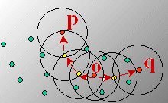
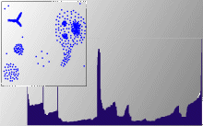
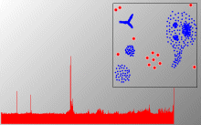
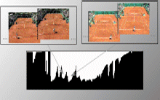
Density-Based Clustering: OPTICS & Its Applications

Slide 57
Cluster Validation

Slide 58
Cluster Validity
For supervised classification we have a variety of measures to evaluate how good our model is
Accuracy, precision, recall
For cluster analysis, the analogous question is how to evaluate the “goodness” of the resulting clusters?
But “clusters are in the eye of the beholder”!
Then why do we want to evaluate them?
To avoid finding patterns in noise
To compare clustering algorithms
To compare two sets of clusters
To compare two clusters

Slide 59
Clusters found in Random Data
Random Points
DBSCAN
K-means
Complete Link

Slide 60
Different Aspects of Cluster Validation
Determining the clustering tendency of a set of data, i.e., distinguishing whether non-random structure actually exists in the data.
Comparing the results of a cluster analysis to externally known results, e.g., to externally given class labels.
Evaluating how well the results of a cluster analysis fit the data without reference to external information.
- Use only the data
Comparing the results of two different sets of cluster analyses to determine which is better.
Determining the ‘correct’ number of clusters.
For 2, 3, and 4, we can further distinguish whether we want to evaluate the entire clustering or just individual clusters.

Slide 61

Clustering Tendency
All clustering algorithms find some clusters, whether data has natural clusters or not.
We need a mechanism to check if at least some clusters are of good quality
Alternatively, we can directly check the data for clustering tendency. A common approach is to use statistical tests for spatial randomness (in Euclidean space) among data points.
Hopkins Statistic : Use p points from data and generate a set of p random points in data space. Let u_{i} be nearest neighbor distances in generated data and w_{i} be nearest neighbor distances in supplied data. Hopkin statistic H is defined as
H is closer to 0 => data is highly clustered;
H is closer to 0.5 => data is uniformly distributed in data space

Slide 62
Evaluation measures for Cluster Validity
Unsupervised Measures without resort to external information, also referred internal indices e.g. SSE.
Measures can be
Cluster Cohesion (compactness, tightness) - how closely related the objects in a cluster are?
Cluster Separation (isolation) - how distinct or well-separated a cluster is from other clusters
Supervised Measures match the clustering output to some external structure, also referred external indices e.g. entropy
Measures how well cluster labels match externally supplied class labels.
Relative - compare different clustering outcomes. can be based on supervised or unsupervised measures, e.g. two K-means clustering outputs can be compared using either SSE or entropy.

Slide 63
Internal Measures: SSE
Clusters in more complicated figures aren’t well separated
Internal Index: Used to measure the goodness of a clustering structure without respect to external information
SSE
SSE is good for comparing two clusterings or two clusters (average SSE).
Can also be used to estimate the number of clusters

Slide 64
Internal Measures: Cohesion and Separation
Cluster Cohesion: Measures how closely related are objects in a cluster
Example: SSE
Cluster Separation: Measure how distinct or well-separated a cluster is from other clusters
Example: Squared Error
Cohesion is measured by the within cluster sum of squares (SSE)
Separation is measured by the between cluster sum of squares
Where |C_{i}| is the size of cluster i

Slide 65
Measuring Clustering Quality: Extrinsic Methods
Clustering quality measure: Q(C, C_{g}), for a clustering C given the ground truth C_{g}.
Q is good if it satisfies the following 4 essential criteria
Cluster homogeneity: the purer, the better
Cluster completeness: should assign objects belong to the same category in the ground truth to the same cluster
Rag bag: putting a heterogeneous object into a pure cluster should be penalized more than putting it into a rag bag (i.e., “miscellaneous” or “other” category)
Small cluster preservation: splitting a small category into pieces is more harmful than splitting a large category into pieces
65

Slide 66
Measuring Clustering Quality
Two methods: extrinsic vs. intrinsic
Extrinsic: supervised, i.e., the ground truth is available
Compare a clustering against the ground truth using certain clustering quality measure
Ex. BCubed precision and recall metrics (averaged over all classes)
Intrinsic: unsupervised, i.e., the ground truth is unavailable
Evaluate the goodness of a clustering by considering how well the clusters are separated, and how compact the clusters are
Ex. Silhouette coefficient
66

Slide 67
Classification-based Measures of Cluster Validity
Precision: The fraction of a cluster that consists of objects of a specified class. The precision of cluster i with respect to a class j is precision(i,j) = p_{ij}
Recall: The extent to which a cluster contains all objects of a specified class. The recall of cluster i with respect to class j is recall(i, j) = m_{ij}/m_{j} where m_{j} is the number of objects in class j.
F-measure: A combination of both precision and recall that measures the extent to which a cluster contains only objects of a particular class and all objects of that class. The F-measure of cluster i with respect to class j is
F(i,j) = (2*precision(i,j)*recall(i,j))/(precision(i,j)+recall(i,j))

Slide 68
External Measures of Cluster Validity: Precision/Recall
Cluster | Entertainment | Financial | Foreign | Metro | National | Sports | Totals
1 | 3 | 5 | 40 | 506 | 96 | 27 | 677
2 | 4 | 7 | 280 | 29 | 39 | 2 | 361
3 | 1 | 1 | 1 | 7 | 4 | 671 | 685
4 | 10 | 162 | 3 | 119 | 73 | 2 | 369
5 | 331 | 22 | 5 | 70 | 13 | 23 | 464
6 | 5 | 358 | 12 | 212 | 48 | 13 | 648
Total | 354 | 555 | 341 | 943 | 273 | 738
K-means clustering result for a newspaper articles document data set
For Cluster 1 and Metro class,
Precision = 506/677 = 0.75
Recall = 506/943 = 0.54
F-value = 0.63
For Cluster 3 and Sports class,
Precision = 671/685 = 0.98
Recall = 671/738 = 0.91
F-value = 0.94

Slide 69
Final Comment on Cluster Validity
“The validation of clustering structures is the most difficult and frustrating part of cluster analysis.
Without a strong effort in this direction, cluster analysis will remain a black art accessible only to those true believers who have experience and great courage.”
Algorithms for Clustering Data, Jain and Dubes

